Slide 1
Comparing Hidden Markov Models (HMM), Recurrent Neural Network (RNN), and Long Short-Term Memory (LSTM)

Slide 2
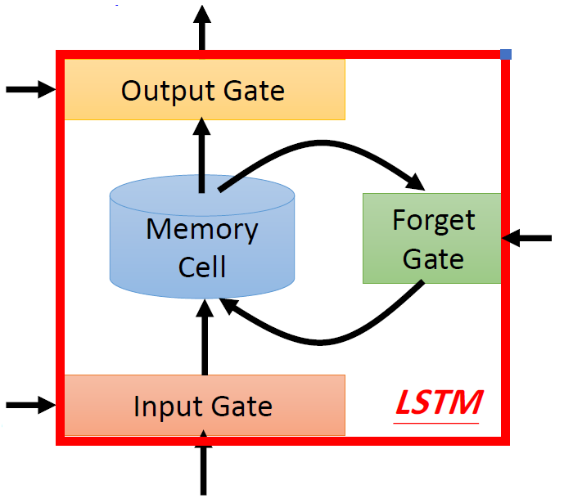
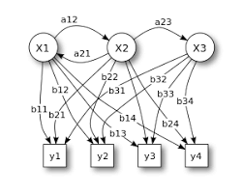
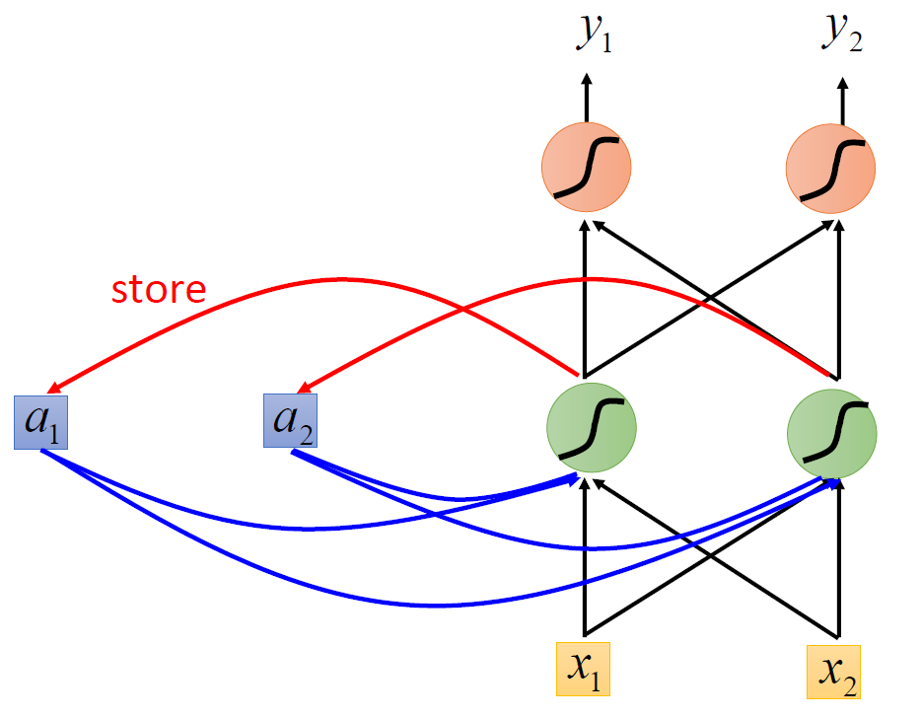
Similarities between HMM, RNN, and LSTM
More precisely, all models can be used for modeling the distribution of a sequence of random observations from a set of variables.
HMM
RNN
LSTM

Slide 3
Comparing Hidden Markov Models (HMM) and Recurrent Neural Network (RNN)
However, in RNN, the variable is deterministically deduced from the current observation and the previous variable, while, in HMM, the variables are random.

Slide 4
What is the difference between HMM and LSTM?
The Hidden Markov Model relies on statistics and distributions, and therefore probability maximization, whereas a LSTM searches for relations in the data set.

Slide 5
Stock prediction using a Hidden Markov Model versus a Long Short-Term Memory
The conclusion of this study is therefore that given the results, the HMM is the better performing model when predicting stock prices when comparing it with the LSTM.

Slide 6
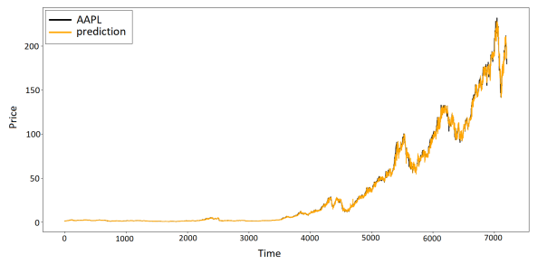
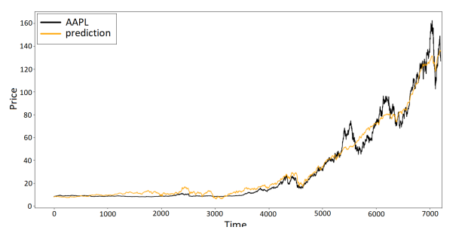
Comparing Hidden Markov Models (HMM) and Long Short Term Memory (LSTM)
The predictions made by the HMM versus the actual data.
The predictions made by the LSTM versus the actual data.

Slide 7
What is the difference between LSTM and RNN?
The main difference between RNN and LSTM (Long Short-Term Memory) lies in their ability to effectively handle long-range dependencies in sequential data.
While RNNs suffer from vanishing gradient problems, LSTMs employ a more sophisticated architecture with memory cells and gating mechanisms.

